Slide 1
Housing Development Corp. of SW Florida, d/b/a HELP
Expanding Homeownership Opportunities

Slide 2
Housing, Education, Lending Programs
3200 Bailey Lane Ste. 109. Naples, FL 34105
www.floridahelp.org
239-434-2397

Slide 3
HELP (Housing, Education, Lending Programs)
HUD Approved Non-Profit Agency
Services Provided:
Home Buyer Education
Pre-purchase and Credit Counseling
Foreclosure Prevention Counseling
OUR MISSION:
HELP exists to promote home ownership opportunities and financial strength through education and counseling

Slide 4
Homebuyer Education
Online
99.00 per household Virtual workshops offered periodically
At your leisure
6 - 8 hr. course
English and Spanish
Register online
www.floridahelp.org

Slide 5
Homebuyer Education Topics
10 Home Buyer STEPS
MONEY MANAGEMENT
UNDERSTANDING CREDIT
OBTAINING A MORTGAGE/LOAN PROGRAM
SELECTING A HOME

Slide 6
Capital
Capacity
Collateral
Assets/Down Payment
Income (2 yrs.)
Credit Report
Debt Ratios
Security
Appraisal
Character
The 4 C’s of Pre-approval

Slide 7
Pre-Purchase Counseling
Individual – privacy assured
Review of tri-merge RMCR – soft pull so there is no credit impact; cost - $30 per borrower
Customized action plan to improve scores if necessary
Review of household budget to identify areas to improve monthly cashflow
Review of housing and total debt ratios and how they impact qualification
Review of available loan and down payment assistance programs

Slide 8
Register for Counseling
Call: (239) 434-2397 ext. 200
www.floridahelp.org – “Start an Application”

Slide 9
Down Payment Assistance
Local funds – (SHIP, HOME, CDBG) as available, standalone
Home | Collier County Affordable Housing (colliercountyhousing.com)
FHFC (a/k/a Florida Bond, HomeTown Heroes) – www.floridahousing.org, Home Buyer Program Wizard
Investor-specific combo programs – FHLB ($10,000, forgivable); portfolio loans with dpa or grant subsidy

Slide 10
Specialized Financing
Local lenders provide CRA loans – borrowers at or below 80% AMI or property located in low or moderate income census tract
Loan benefits include below market rates, low down payment options, and NO mortgage insurance

Slide 11
Collier County Community Land Trust
www.collierclt.org
Alternative to high priced rent
Trust retains ownership of land – purchase improved property
Ground lease with very minimal payment – contains resale formula
Supplemental education required

Slide 12
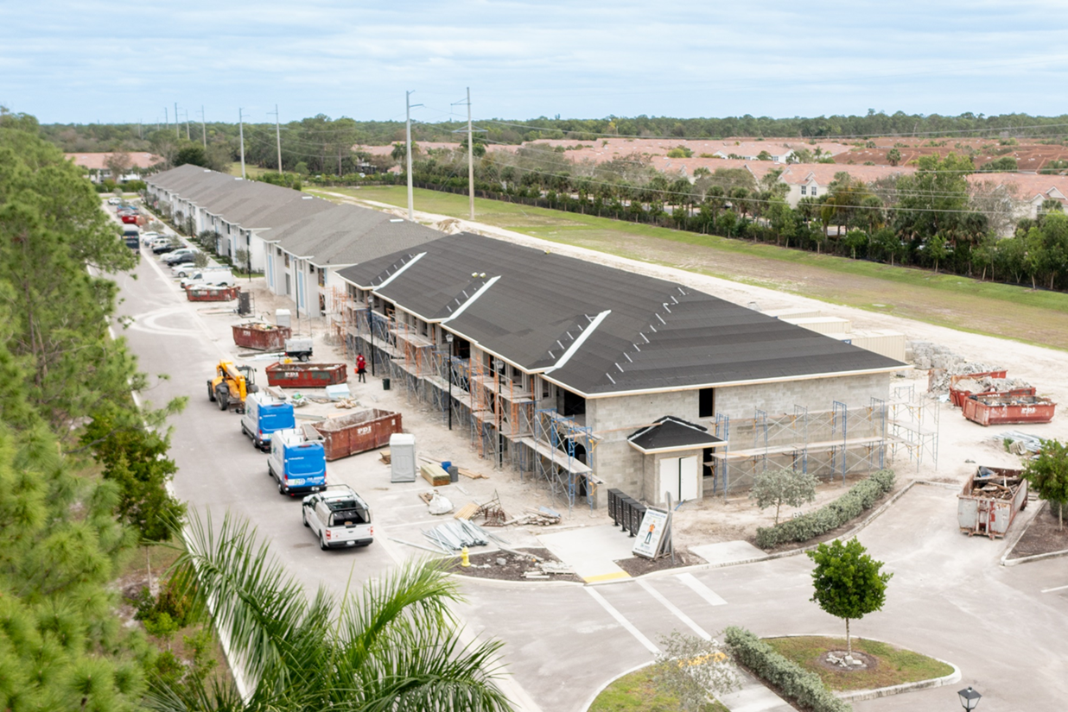
Opening Doors
Strength & Stability Through Homeownership

Slide 13
Basic Requirements
Need
Ability to Partner
Ability to Pay
Example, expensive rent, living in crowded conditions, unsafe neighborhood etc.…
Must be willing to work a minimum of 500 construction volunteer hours, provide all family’s financial documents every month, participate in classes, and workshops.
Must have stable and reliable source of income, a minimum of $35K. There is a maximum amount base on the family size.

Slide 14
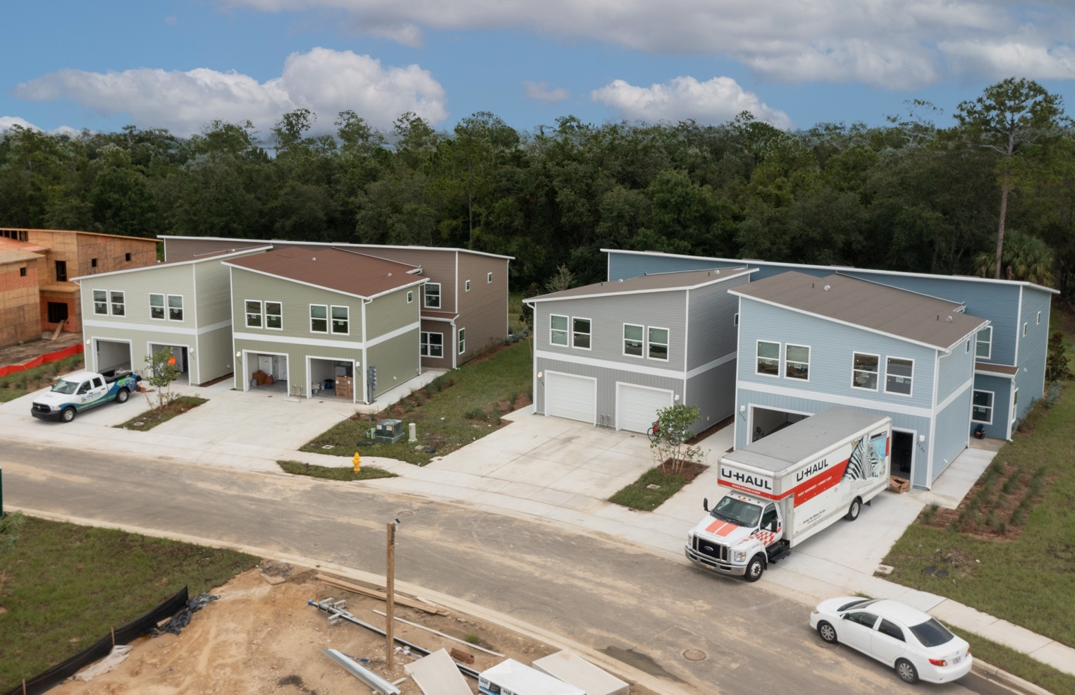
Notes:
Habitat Collier serves families in Naples and Immokalee by providing safe, stable, affordable housing to qualified families through zero-interest mortgages.

Slide 15
Collier County Resident
Legal Status
First Time Homebuyer
Must be a Collier County resident for 1 year or work in Collier County for a minimum of 1 year.
Must be a USA citizen or legal resident of the USA
Have not owned a property for 3 years.

Slide 17
Fair Housing Act
Enforced by Department of Housing and Urban Development (HUD)
Prohibits discrimination and intimidation in homes, apartments, condos
Equal access to rental housing and homeownership opportunities
Race, Color, National Origin, Religion, Sex, Familial Status, Disability
www.hud.gov/fairhousing ;
Fair Housing | Collier County Affordable Housing (colliercountyhousing.com)

Slide 18
Q&A Thank you for joining us today – we look forward to working with you!

